Slide 1
School Database Management System
MEMBERS:
AAKASH SHRESTHA (THA076BEI001)
AAKASH SINGH THAPA (THA076BEI002)
BISHWAMBHAR DAHAL (THA076BEI009)
RAJAT DULAL (THA076BEI020)
DEPARTMENT OF COMPUTER AND ELECTRONICS ENGINEERING
INSTRUCTOR:
RAMA BASTOLA

Slide 2
Table of Contents
Introduction
Motivation
Functionality of School Database Management System
Limitations of our School Database Management System
Entity Relationship Diagram
Schemas in our Project
View used in our Project
Program Flow

Slide 3
Motivation:
We were motivated by the following problem:
Long Queue at entrance form at start of each academic year
Repetitive Process conducted at end of each academic year
Conflicts in communication between student and teacher
Tedious Marksheet report generation

Slide 4
Introduction
The “School” word in our Project refers to the higher secondary school level
This project helps to digitize the processes involved in storing information and generating useful data in schools.
Our project uses tools such as:
MySQL database
Python applications(app) to add or modify data in database:
Admin app: Given only to admin
Student app: It will be distributed to students
Teacher app: It will be distributed to teachers

Slide 5
FUNCTIONALITIES OF SCHOOL DATABASE MANAGEMENT SYSTEM
1)Easy Data Access to Authorized School Administrator/Admin
- Data regarding student and teacher can be stored and accessed by administrator in an easier, secure and convenient manner.
2)Student And Teacher Login:
- Login system allows the user to access limited resource from database which is defined by admin.
- Different functions are provided to student and teacher after they are logged in.

Slide 6
3) Data Security
-Every action by admin is recorded so that back tracing can be done incase data tempered situation occurs.
-Triggers are used to record updates in student teacher details.
4) Messaging System
- Facilitates the communication between teacher, student and admin.
- Features:
i) seen/unseen status
ii) shows inbox messages
iii) admin could send message to group
iv) student/teachers could be searched by keywords

Slide 7
5) Faster Admission Process
- has online registration feature which reduces the long queue of students and parent in front of school.
6) Marksheet Management
- Teachers can insert/update the marks of students form their home.
- Students can view their progress report simply by logging into their account.
7) User password Management
- Passwords are stored in binary hash form in DB.
- Forget password is managed by OTP system.

Slide 8
8) Dynamic Nature of System
Marksheet table/view are created and deleted according to addition or deletion of category dynamically in real time.
Provides longevity to the system.
9) Permission Control
- Has three user- student, teacher and root.
- Required permission is granted to user by admin on specific instances only.
- Some permissions are granted and revoked automatically.

Slide 9
10) Validation of data
All entered data are validated before inserting into the database to avoid invalid data.
11) Data Recovery
Commit and rollback is used for safe transaction of data.

Slide 10
LIMITATIONS OF OUR SCHOOL DATABASE MANAGEMENT SYSTEM
No Proper UI Design (No Use of Front-End techniques)
Account and Library Section which are also a part of a school are not given access to the database.
In real colleges, Scholarships are provided to students on the basis of entrance marks. This feature hasn’t been added in our system.
Since the entrance marks is only used by any college for admission purpose only, we have treated the entrance marks for all faculties in the same manner i.e., in a same table.

Slide 11
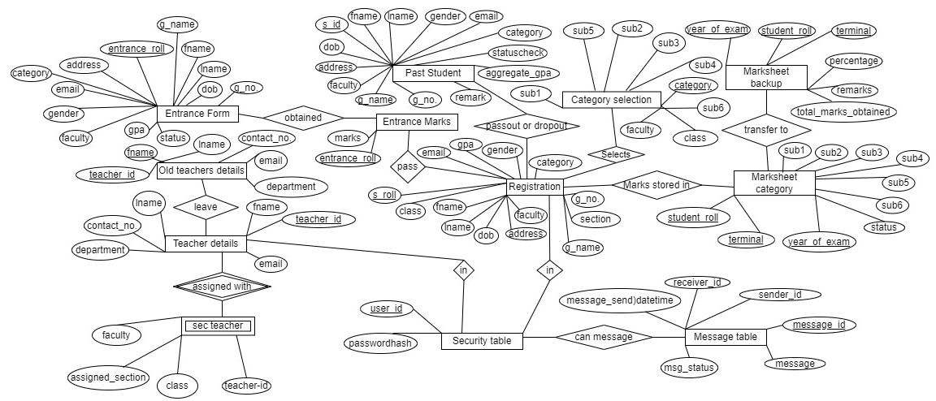
Entity Relationship Diagram

Slide 12
Schemas in our Project
Activity_record schema:
Sn is the primary key with auto increment
The other attributes are: activity_by,activity,activity_status, activity_on and not null is assigned to all of them
Activity_on is of time datetime and value is generated automatically
Category_selection Schema:
Adding a category in this table automatically generates marksheet table for the added category
The attributes are category,class,faculty,subject1,subject2 etc
Category is the primary key
Not null is assigned to all attributes except subject6 as it is optional subject

Slide 13
Continued
Entrance_form Schema:
Its attributes are: entrance_roll,fname, dob,gpa etc
Entrance_roll is the primary key
Not null is assigned to all attributes
Gpa has domain constraint of 0 to 4
Statuscheck has domain constraint of one value between the set :(Waiting, Approved, Rejected)
Entrance_marks:
Its attributes are entrance_roll and marks
Entrance roll is the primary key
Marks has domain constraint of 0 to 100
Not null is assigned to both of them

Slide 14
Continued…
Marksheet_backup
It containes attributes like year_of_exam, student_roll_number,terminal,percentage, total, remark etc
Year_of_exam, student_roll_number and terminal are assigned primary key
Not null is assigned to all attributes
security_table
Stores sensitive data like password(user_id, passwordhash)
User_id is primary key
Passwordhash has constrain not null

Slide 15
Continued…
student_update_rec
Store trigger for update in student(sn,student_id,action_,action_on,address,email,category,aggregate_gpa,guatdain_name,guardain_number,remarks_further_study,action_date)
Sn is primary key with auto_increment
All other attributes are constrained to NOT NULL except aggregated_gpa,catagory, and remarks_futher_study

Slide 16
Continued…
teacher_details
Store all teacher details (teacher_id,fname,laname,contact_number,email,department)
All attributes are constrained to NOT NULL
teacher_details_update_rec
Store trigger for update in teacher(sn,teacher_id,action_,contact_number,email,action_date)
Sn is primary key with auto_increment
All attributes are constrained to NOT NULL

Slide 17
Continued…
technical_data
Stores filter information from entrance and message table (sn, entrance_appear_stu, approved_in_entrance_stu, max_marks_in_entrance, cutoff_marks_in_entrance, avg_marks_in_entrance_of_approved_stu, avg_marks_in_entrance, total_msg, total_msg_stuTotec, total_msg_tecTostu, total_msg_tecToadmin, total_msg_adminTosec, total_msg_stuToadmin, Datetime_admin_declare_end_of_acedemic_year)
Sn is primary key with auto_increment

Slide 18
Continued…
Past students:
Information of pass or dropout students(Student ID, Name, Address , DOB, etc.
Student ID is Primary Key
Remaining Attributes are constrained to NOT NULL except remark for further study
Registration:
Information of students who passed entrance exam(Student roll, Name, Address, Gender, etc.
Student roll no.(s_roll) is Primary Key
Class value is default to 11 and section is default to “x”

Slide 19
Continued…
Section teacher:
Information of section teacher(Teacher ID, Class, Faculty, Assigned section, etc.
Primary Key is Teacher ID
Remaining attributes are constrained to NOT NULL

Slide 20
Old teacher details:
Old teacher details:
Information of teacher who left the school(Teacher ID , Name(first and last),contact no. ,email , department)
Teacher ID is the Primary Key
Remaining attributes are constrained to NOT NULL
Message table:
Information of message (message id , sender id , receiver id,message send date and time , message status)
Message ID is the Primary Key and auto_increment
Remaining attributes are constrained to NOT NULL

Slide 21
Continued…
Marksheet_category_{cat}
Store marks of student(year_of_exam, student_id, terminal, sub1,sub2,sub3, sub4, sub5)
Year_of_exam, student_id and terminal is assigned primary key

Slide 22
View used in our Project:
Mark sheet calculation View
Section teacher details view
Mark sheet backup analysis view

Slide 23
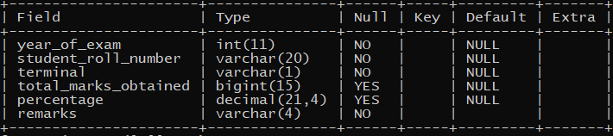
Mark sheet calculation View
Remarks:
Dynamic View
All marks from marksheet_catagory_{cat} table is added to give total marks
Percentage is calculated from total marks.
‘pass’ is given in remarks if marks in all subject is >= 40 otherwise ‘fail’

Slide 24
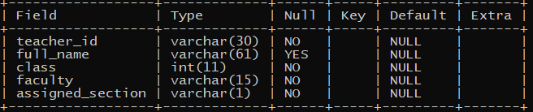
Section teacher details view
Remarks:
Natural join is done between teacher_details and section_teacher.
Fname and lname is concatenated to give full name.
Teacher_id, full_name, class, faculty and assigned-section is displayed

Slide 25
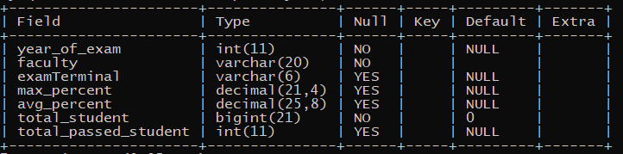
Mark sheet backup analysis view
Remarks:
Union is done between registration table and past_student table followed by inner join with marksheet_backup
Record are grouped by year_of_examination,faculty,terminal
Max_percent, avg_percent is calculated by using max() and avg ()
Total number of student of particular group is calculated buy using count()
Function fn_totalpass is used to return total number of passed student.
Terminals symbol is changed into respective word (like ‘1’ into first)

Slide 26
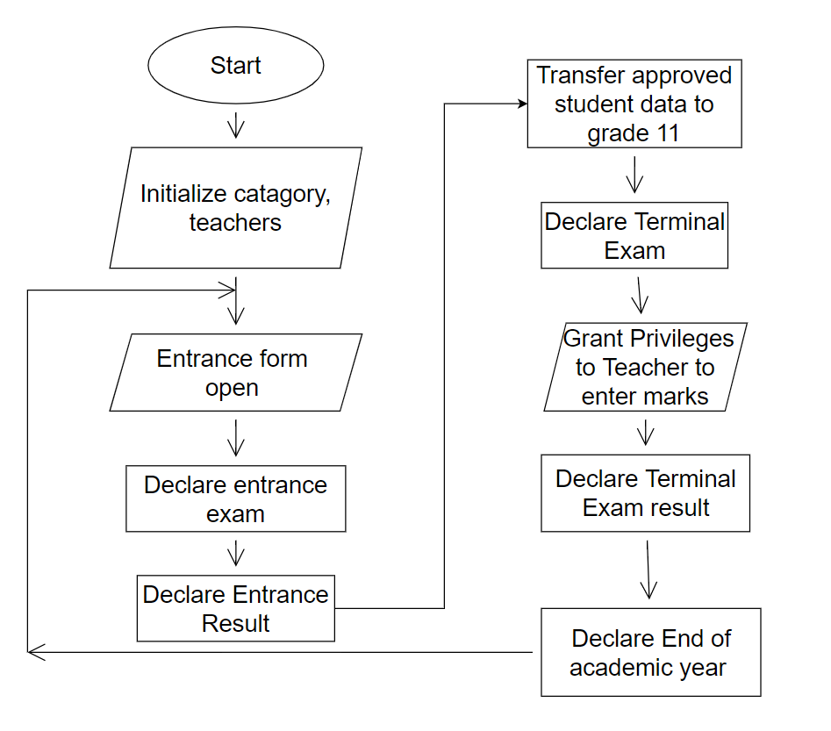
Program Flow:

